Slide 1
RoughMill HMI
A brief How to Operate Summary

Slide 2
Common HMI Objects
Layout
Header
Sidebar
Faults
Messages
OEE

Slide 3
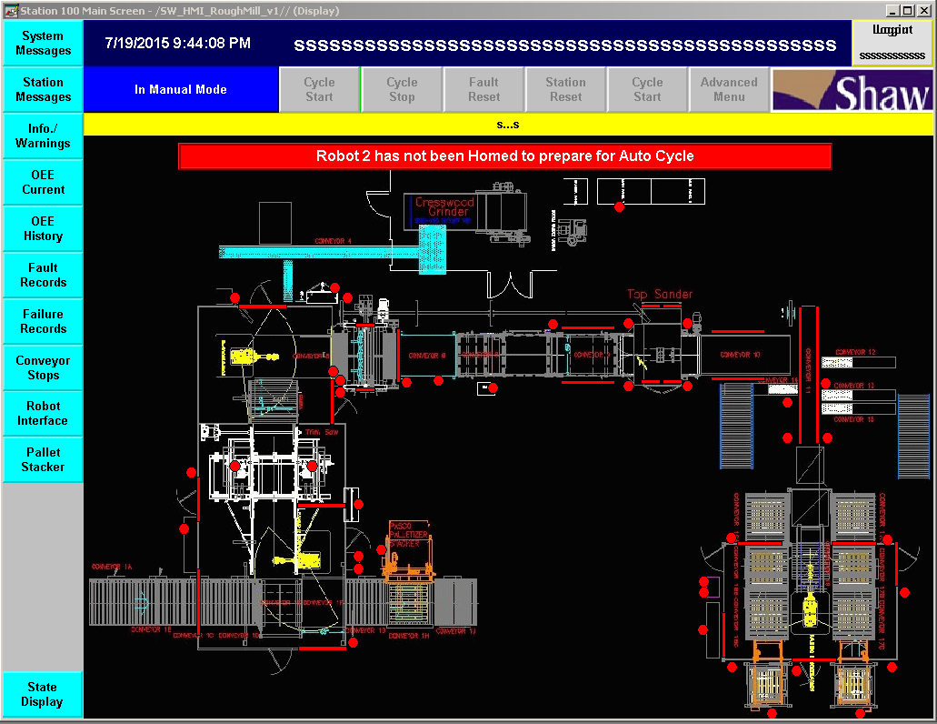
Layout
Header
Side Bar
Common Over View

Slide 4
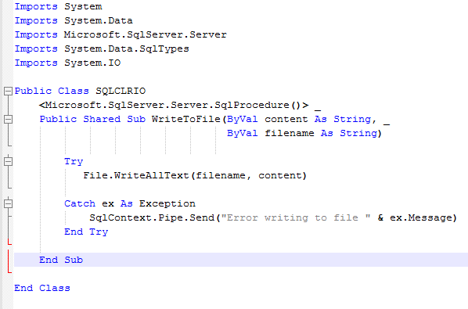
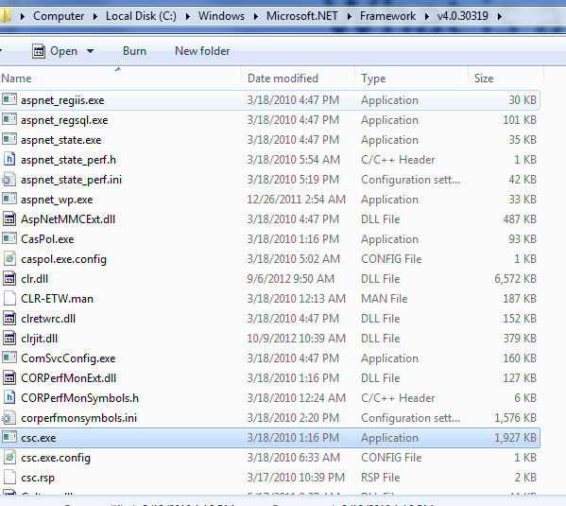
What is a “CLR”?

Slide 5
MSSQL CLR
What is a “CLR”?
How Can I Use It?
Write To File Example.
Align Example.

Slide 6
How Can I Use It?
Write your Code

Slide 7
How Can I Use It?
Compile your Code
c:\Windows\Microsoft.NET\Framework\v4.0.30319\csc.exe /out:WritetoFile.vb

Slide 8
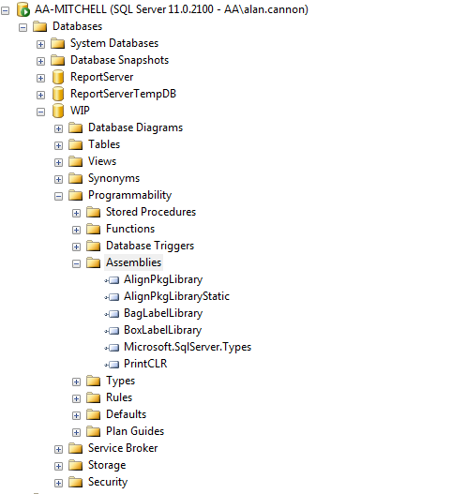
How Can I Use It?
Import your Code (Click)

Slide 9
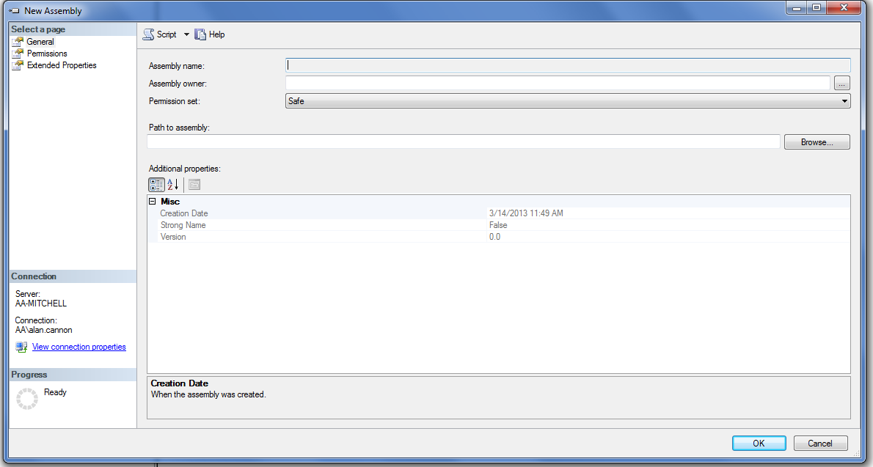
How Can I Use It?
Import your Code (Click)

Slide 10
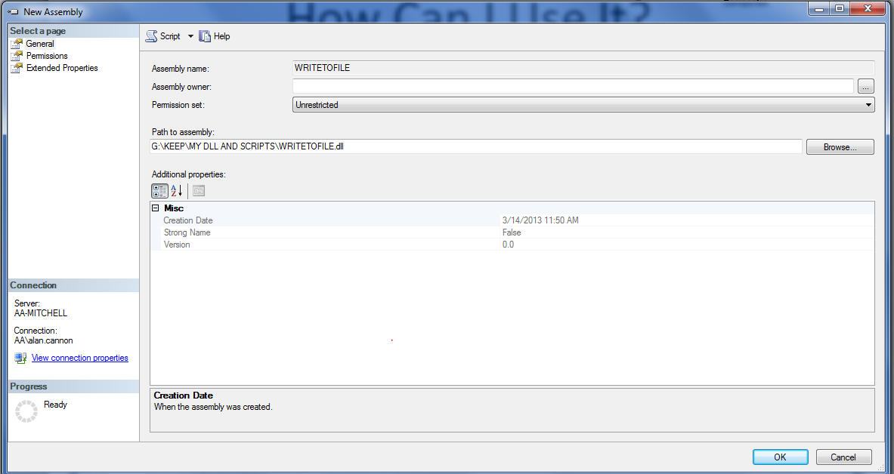
How Can I Use It?
Import your Code (Click)

Slide 11
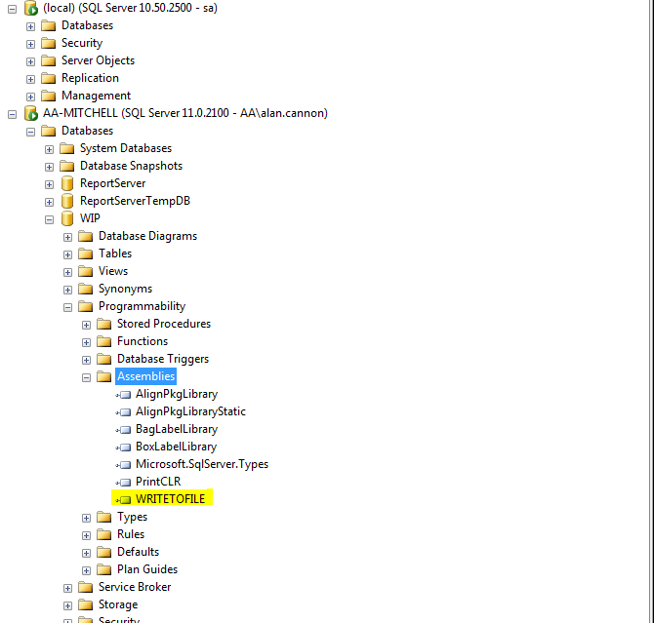
How Can I Use It?
Import your Code (Click)

Slide 12
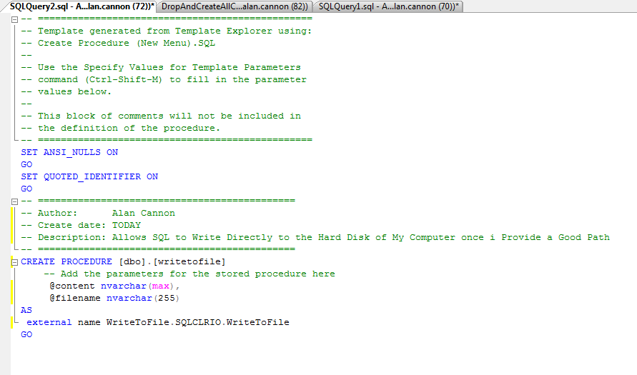
How Can I Use It?
Create your procedure(Click)

Slide 13
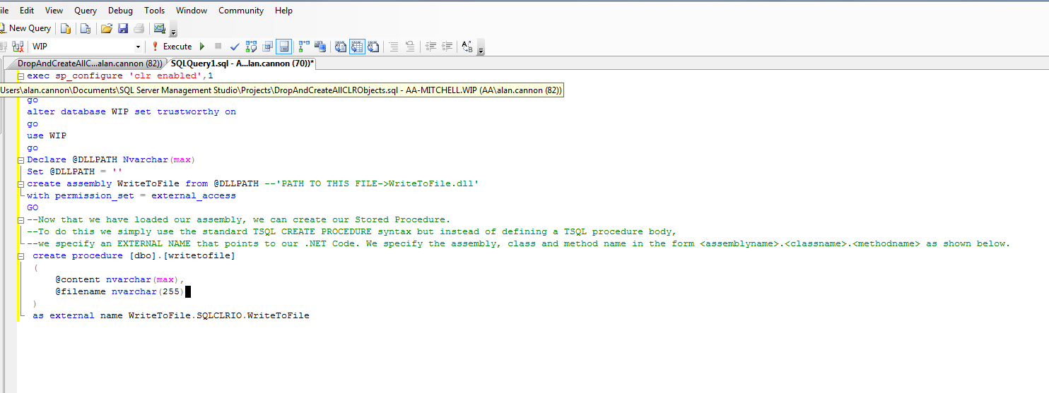
How Can I Use It?
Import your Code(Code Based)

Slide 14
MSSQL CLR
What is a “CLR”?
How Can I Use It?
Write To File Example.
Align Example.

Slide 15
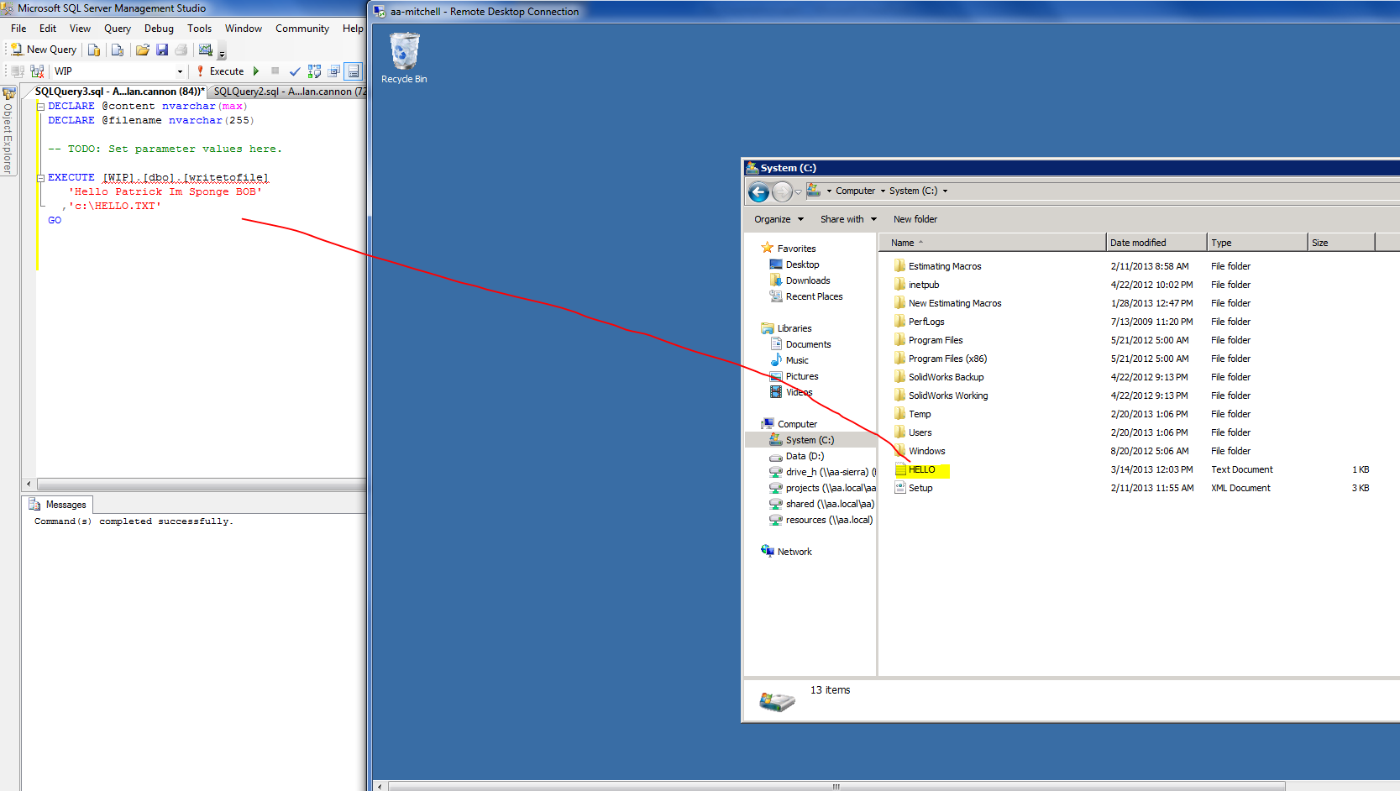
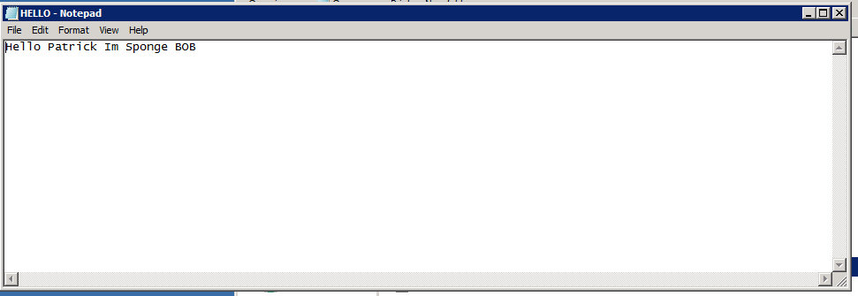
Write to File Example

Slide 16
MSSQL CLR
What is a “CLR”?
How Can I Use It?
Write To File Example.
Align Example.

Slide 17
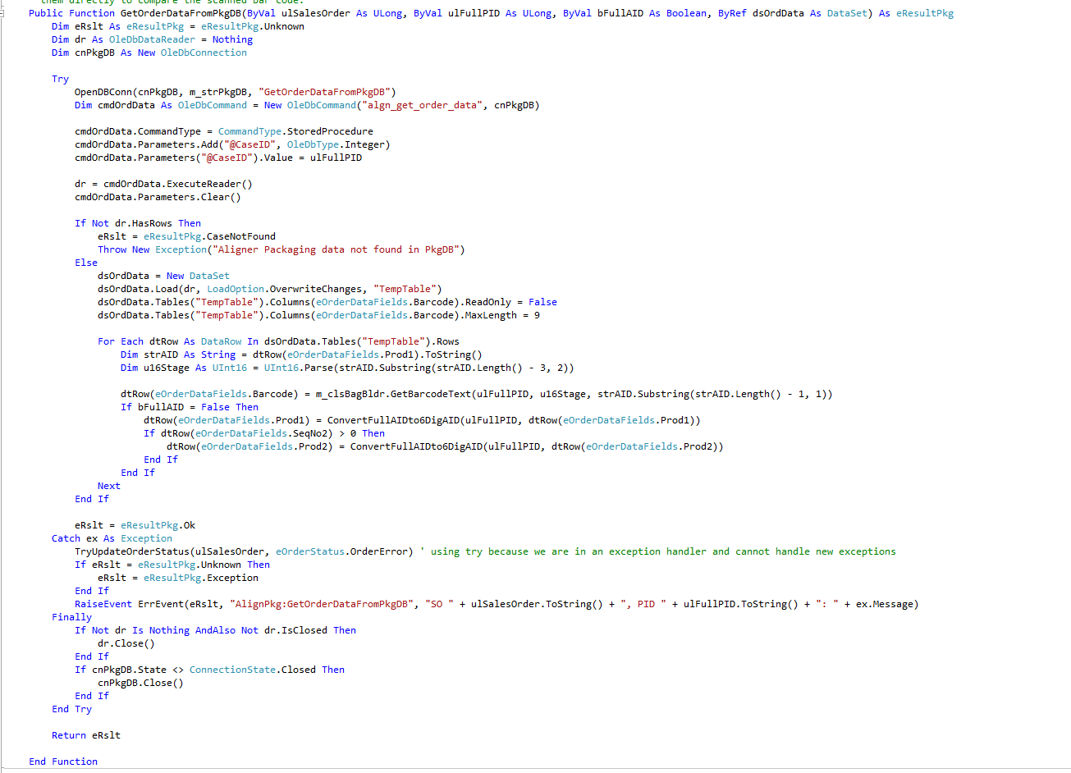
Align Example..

Slide 18
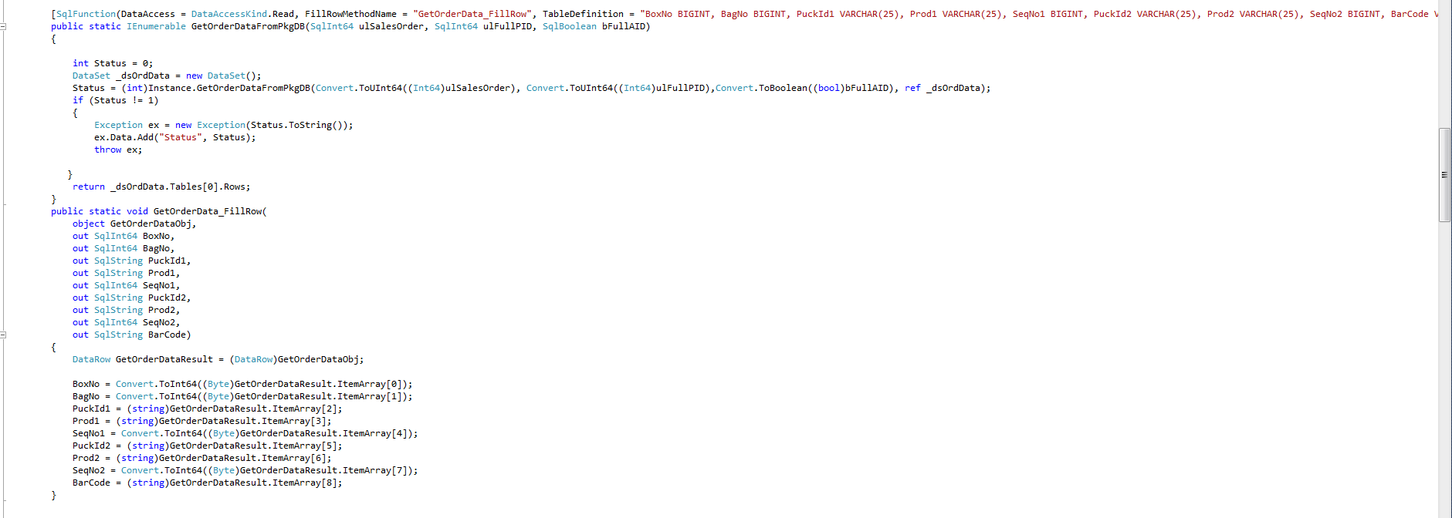
Align Example..

Slide 19
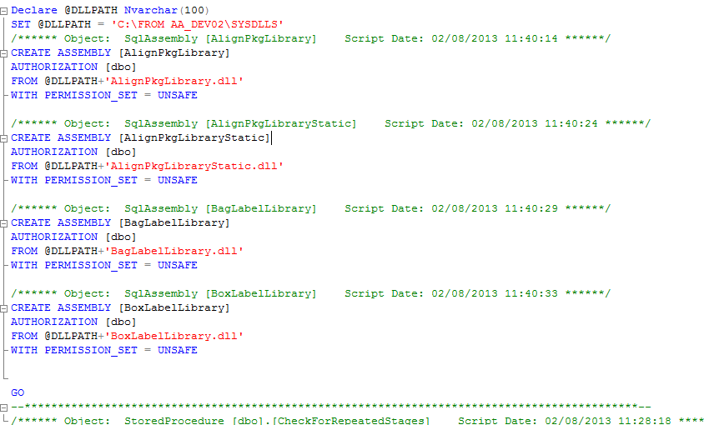
Align Example..

Slide 20
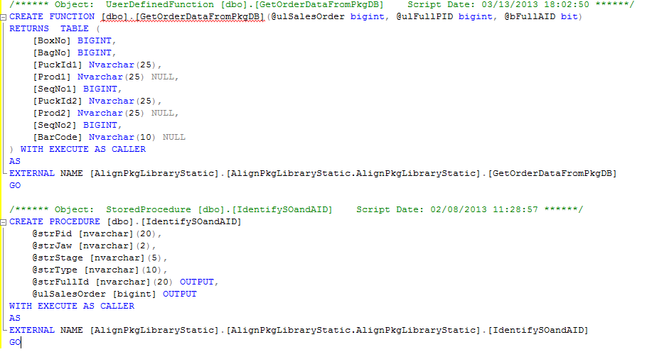
Align Example..

